Slide 1
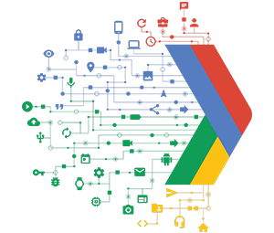

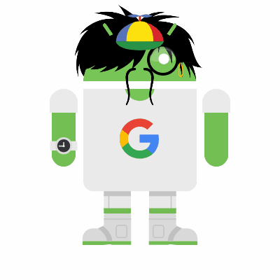
GDG DevFest 2017
Kickstart

Slide 2

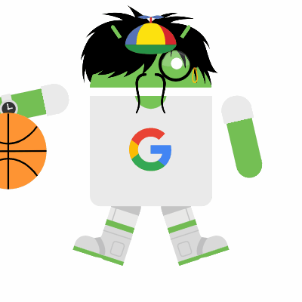
Let’startThe ame

Slide 3



Mobile & Web Application Development Platform

Slide 4



+
=

Slide 5
Why ?
Scalable Platform
Compatible Cross-Platform
Easy to Learn
Easy to Implement
No Server-side Headache
Number of Services
Analytics
By Google :p
& Many More …

Slide 6
Services
Cloud Messaging
Database (Real-time)
Storage
Web Hosting
Authentication
App Testing
Crash Reports
Analytics
& Many More …

Slide 7
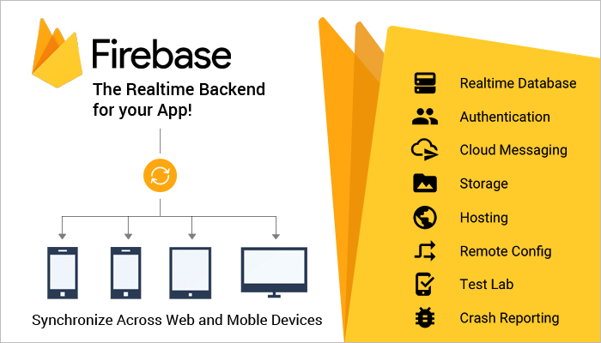

Slide 8
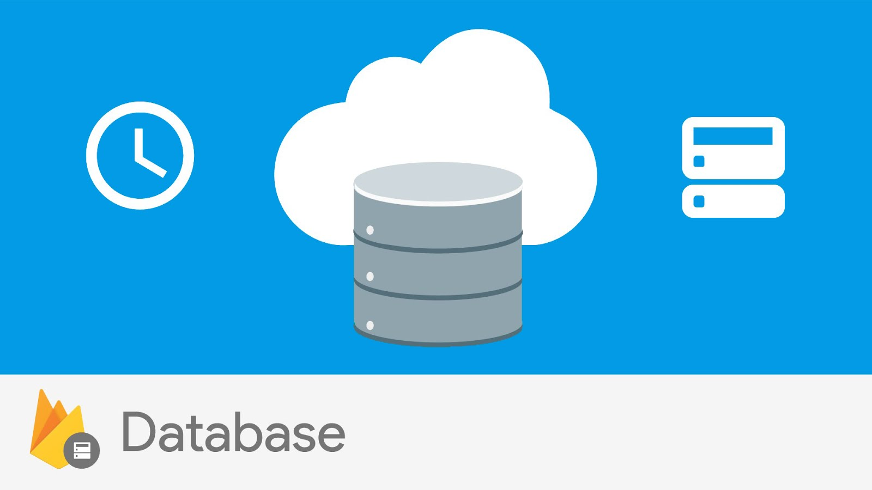

Slide 9
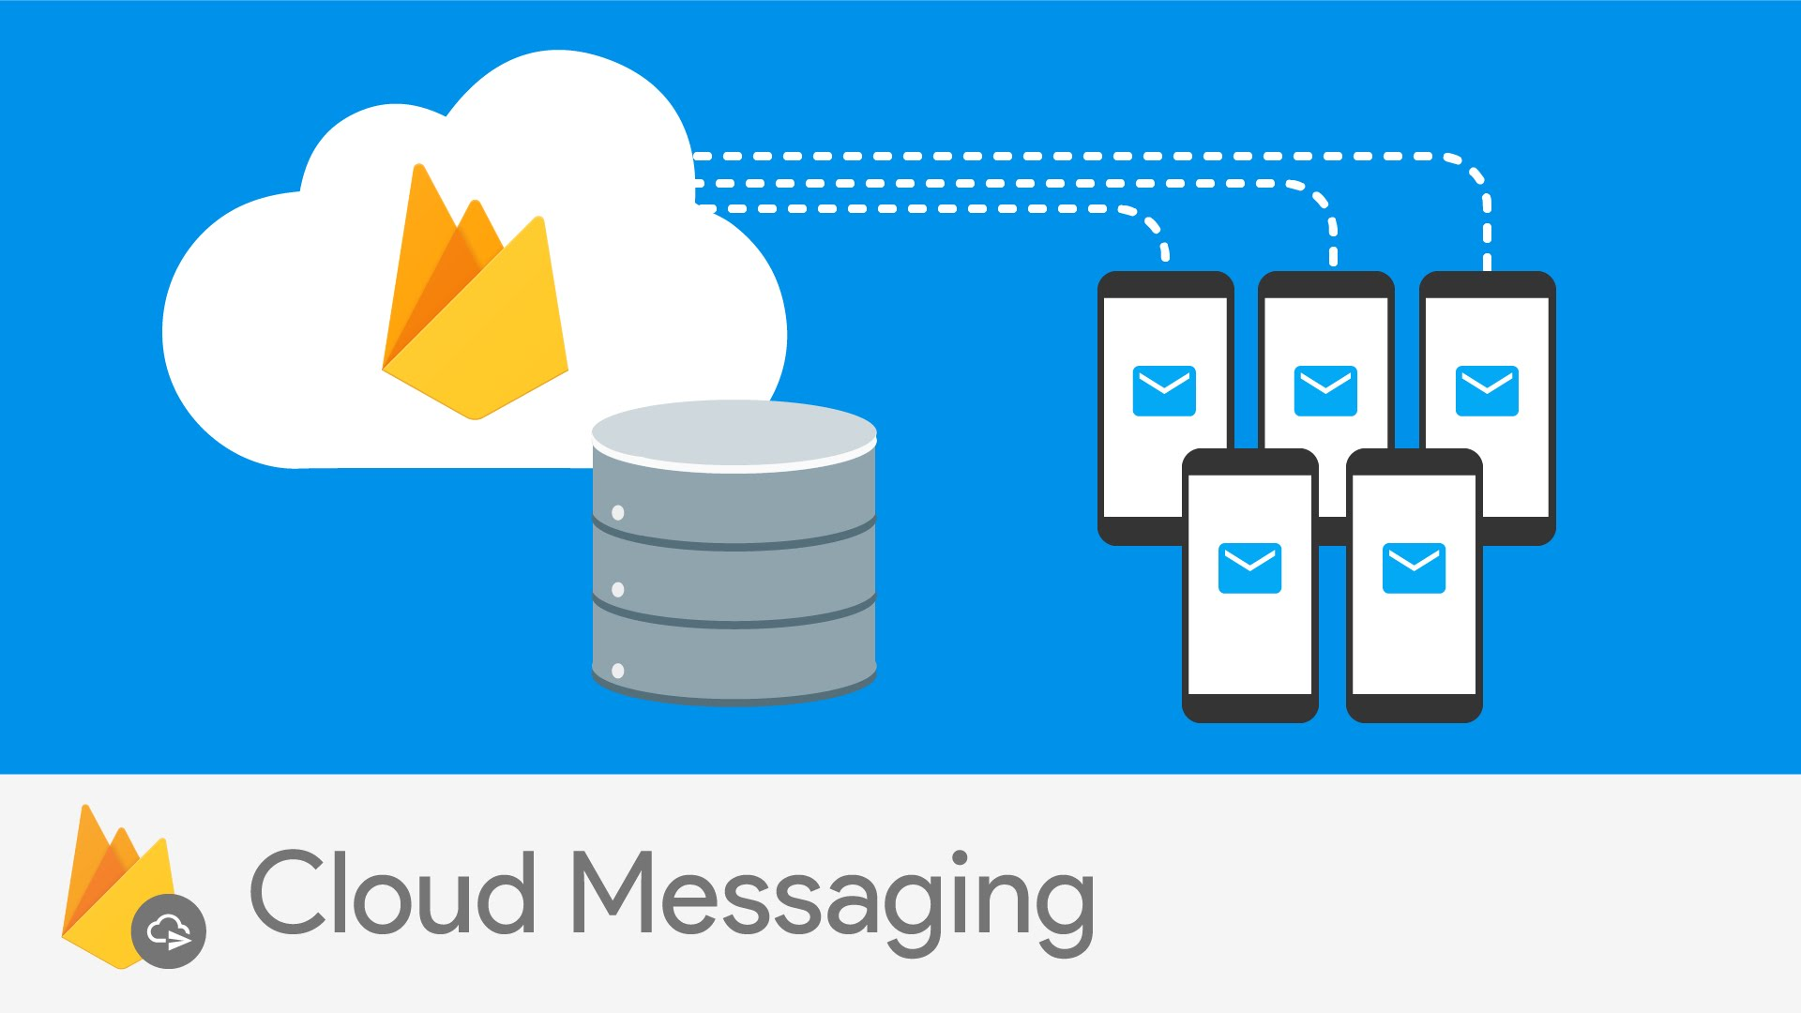

Slide 10
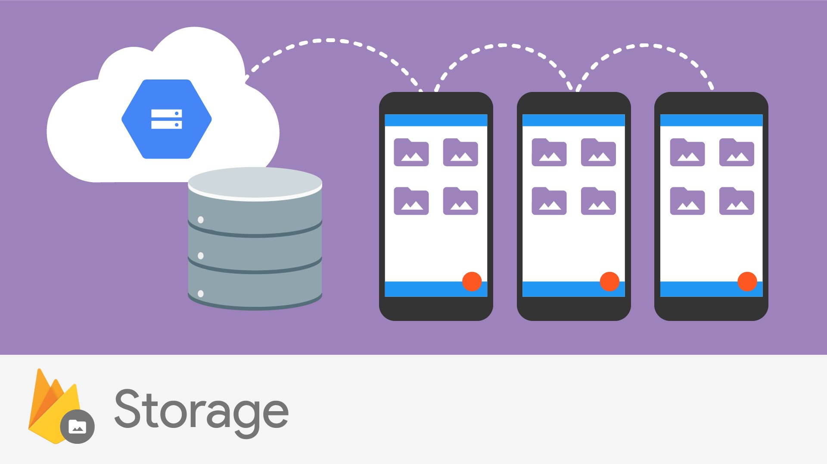

Slide 11
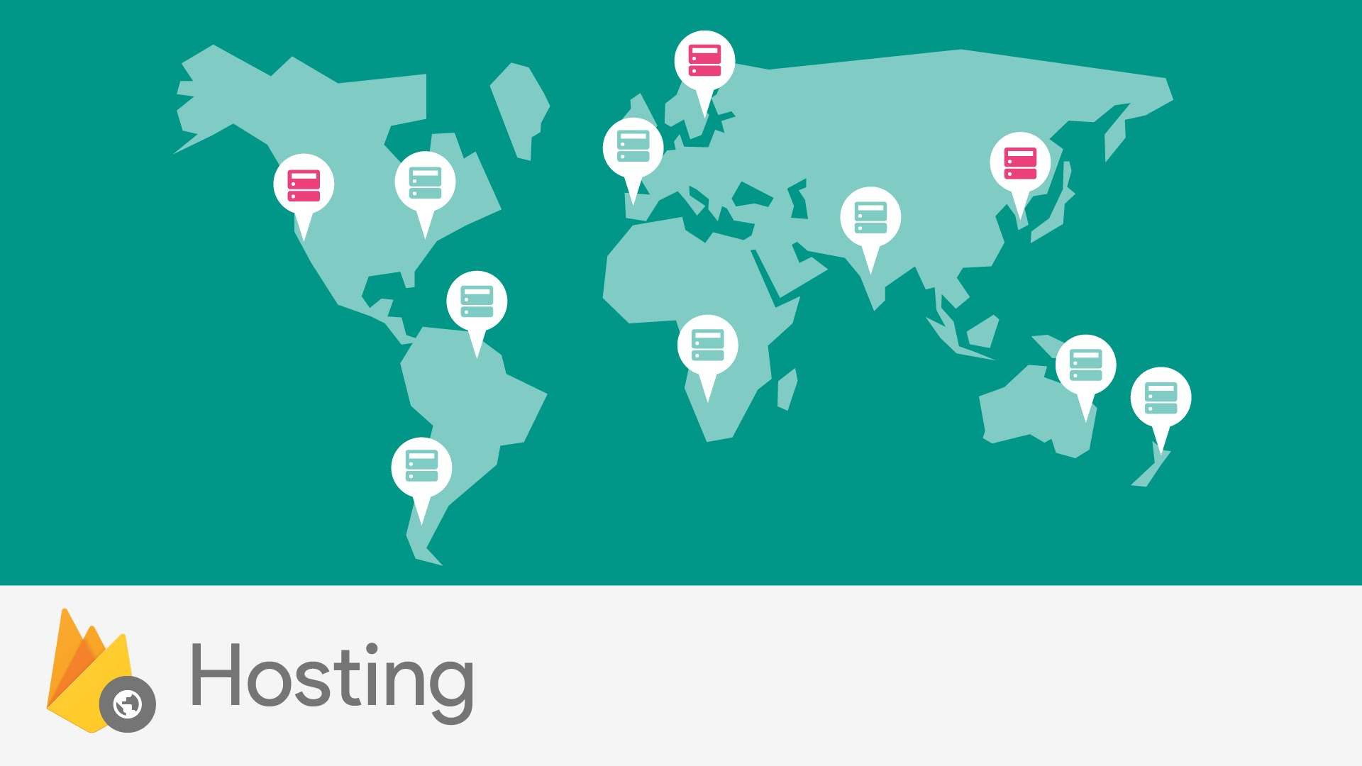

Slide 12
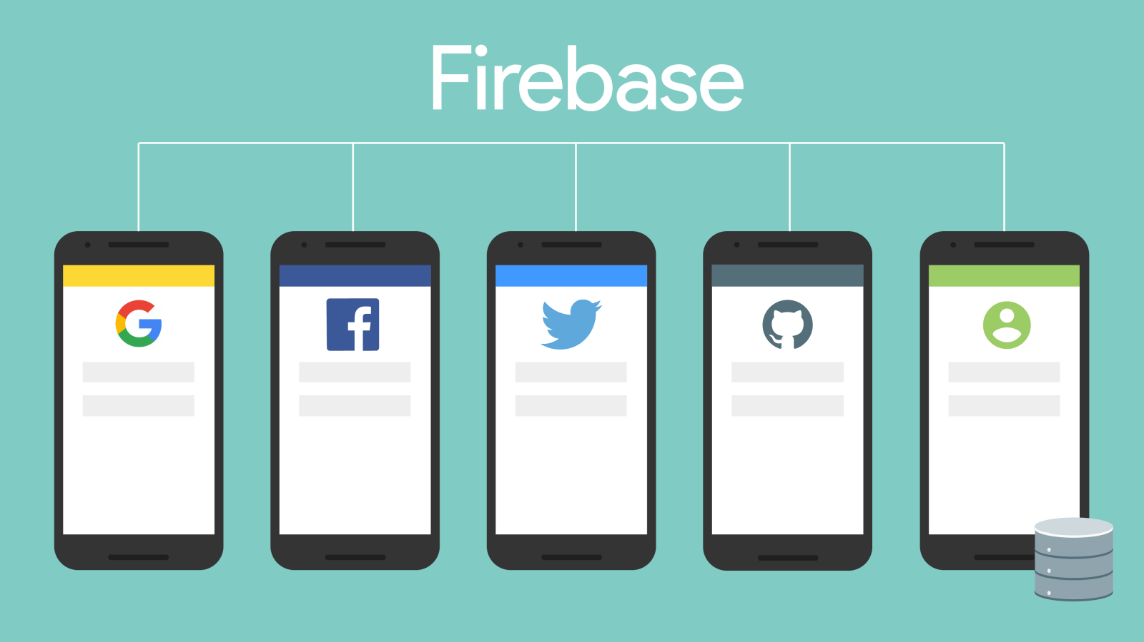

Slide 13
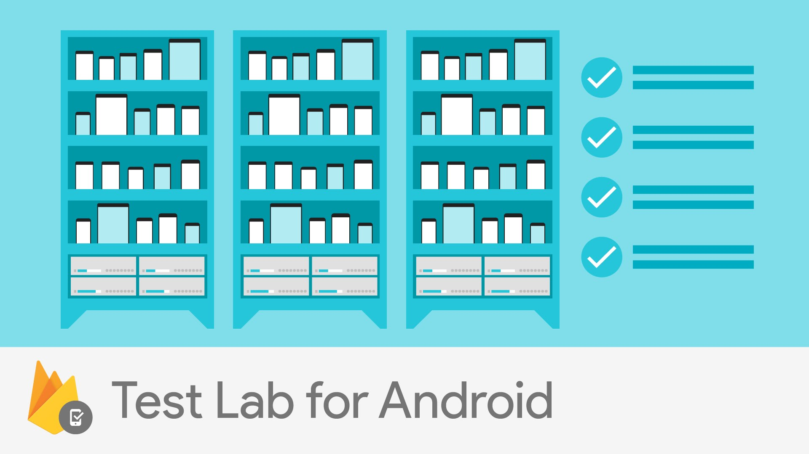

Slide 14
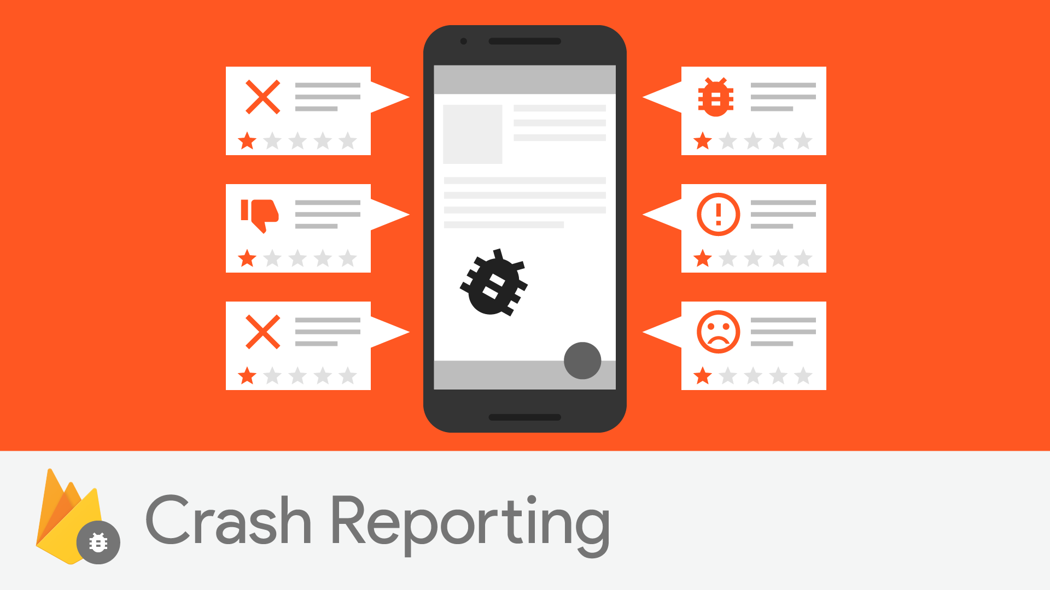

Slide 15
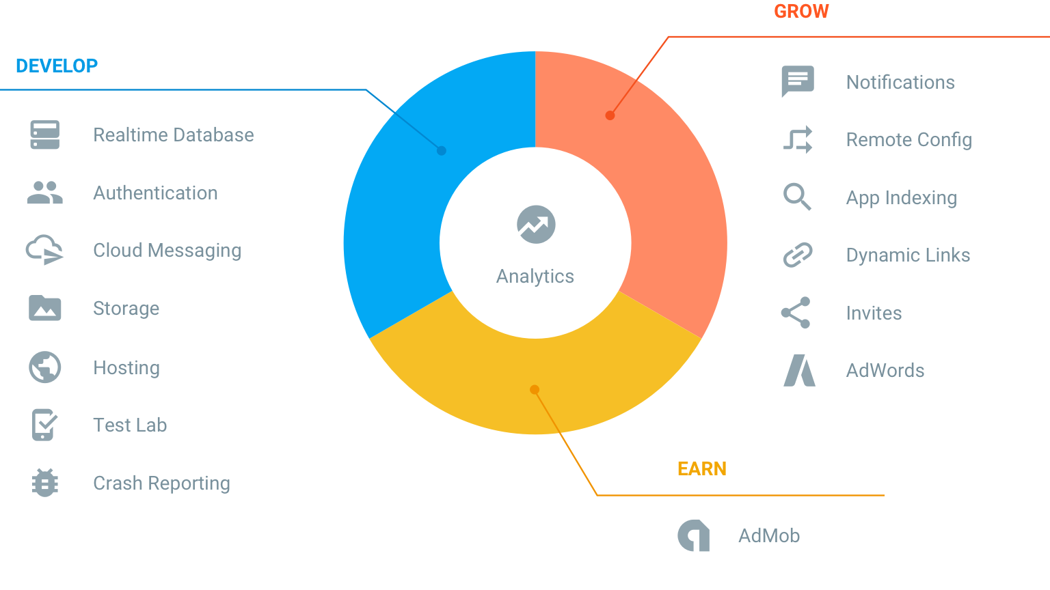

Slide 16
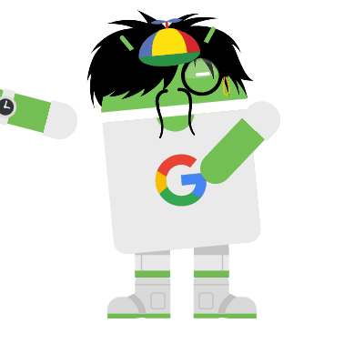
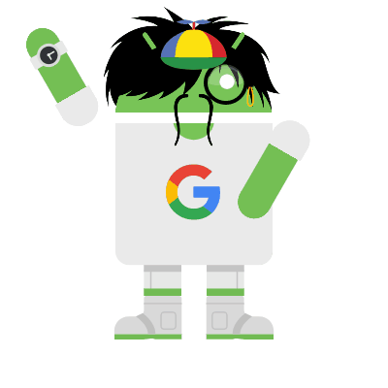
woohoo…. did it

Slide 17
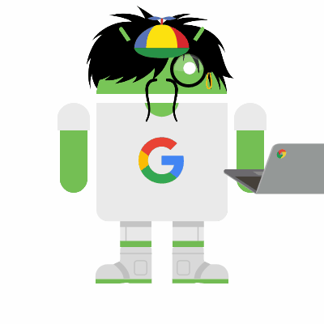
Thank You
- Akshay Saini
(anonyxhappie.github.io)

